Slide 2
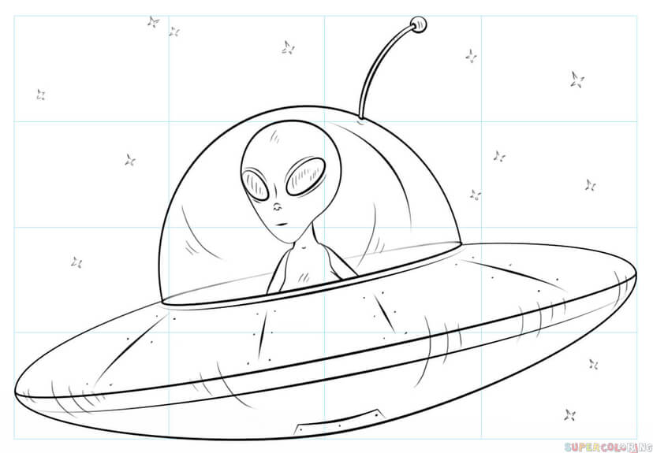
ORDER OF OPERATIONS
{ }
PLEASE
Parentheses
[ ]
( x )
EXCUSE
x²
Exponents
MY DEAR
•
Multiplication and Division
• ÷
•
Do you see the dots???
AUNT SALLY
Addition and Subtraction
+ −
Do you see the dashes???
We say, “DOT BEFORE DASH”

Slide 3
ORDER OF OPERATIONS
DOT BEFORE DASH
DOT BEFORE DASH
{ }
DOT BEFORE DASH
PLEASE
[ ]
Parentheses
( x )
EXCUSE
x²
DOT BEFORE DASH
Exponents
MY DEAR
•
Multiplication and Division
• ÷
•
DOT BEFORE DASH
!!!!
AUNT SALLY
Addition and Subtraction
+ −

Slide 4
x
P
Are there any parentheses?
17 + 2 • 2
x
E
Are there any exponents?
✅
MD
= 17 +
Any “dots”?
4
✅
AS
Last of all…
= 21

Slide 5
How do you make a story SIMPLER????
Cuesta Park

Slide 6
My son Bob took our dog Lola to Cuesta Park on a Sunday to play frisbee.
SIMPLIFY! CUT IT DOWN!
Cuesta Park

Slide 7
Bob took Lola to to the park to play frisbee.
EVEN SIMPLER!

Slide 8
Bob … Lola … park … frisbee.
EVEN SIMPLER!

Slide 9
Bob … Lola … park
EVEN SIMPLER!

Slide 10
Bob … Lola …
EVEN SIMPLER!

Slide 11
?????
Bob ?
Lola?

Slide 12
My son Bob took our dog Lola to Cuesta Park on Sunday to play frisbee.
Bob took Lola to to the park to play frisbee.
Bob … Lola … park … frisbee.
Bob … Lola …
Do you see the Sacred V?

Slide 13
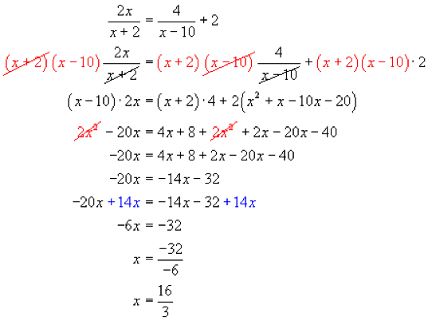
Algebra uses it….
Do you see the Sacred V?

Slide 14
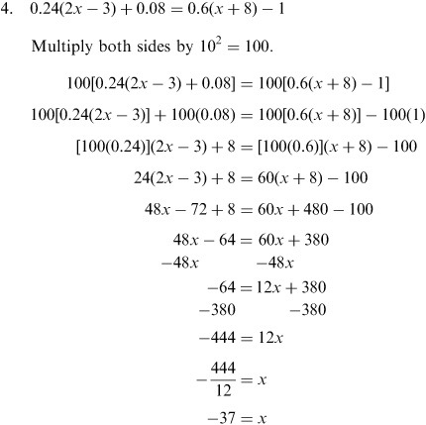
Do you see the Sacred V?

Slide 15
Why the Sacred V?

Slide 16
Let’s do another one:
15 + (12 – 7 ) • 2
P
Are there any parentheses?
✅
x
E
Are there any exponents?
Sacred V warning:
WRITE IT OUT!!
5
• 2
= 15 +
MD
Any mult/division?
✅
✅
AS
Last of all…
= 15 +
10
= 25
Yay!

Slide 17
One more, then Game Time!
2
4 − (12 ÷ 4 ) + 2
P
Are there any parentheses?
✅
E
✅
2
+ 2
Are there any exponents?
4 −
3
Sacred V warning:
WRITE IT OUT!!
MD
x
Any mult/division?
− 3
+ 2
AS
= 16
Last of all…
✅
2
OK, work from left
to right:
= 13 +
= 15
Yay!

Slide 18
Mad Dash
Do at least the FIRST problem on each slide ☺
Copy the problem exactly.
Follow Order of Operations, and use the Sacred V !
Hold up your white board for me to see.
Find a new desk to sit in.

Slide 19
1.
P
a) 7 + 3 ● 5
E
MD
AS
b) 12 + 20 4

Slide 20
Answers …

Slide 21
Did you get at least one
correct?
If not, find your mistake, circle it and show me.
Did you use the Sacred V?
If not, fix that and show me.
OK now?????
7 + 3 ● 5
= 7 + 15
= 22
12 + 20 4
= 12 + 5
= 17
…Find a new
place to sit
(carefully, please!)

Slide 22
2.
P
a) 7 + 10 1 − 5
E
MD
AS
5
b) 20 5 + 2
●

Slide 23
Answers …

Slide 24
Did you get at least one
correct?
If not, find your mistake, circle it and show me.
Did you use the Sacred V?
If not, fix that and show me.
OK now?????
7 + 10 1 – 5
= 7 + 10 – 5
= 17 – 5
= 12
20 5 + 2 ● 5
= 4 + 10
= 14
…Find a new
place to sit
(carefully, please!)

Slide 25
3.
a) 9 +
P
45 9 ● 5
???
E
MD
Left to RIght
AS
Left to RIght
What if there are TWO???
TWO “DOTS” in a ROW?
Is it = 25 or is it = 1?
Shall we vote?
Mathematical democracy???
b) 10 + 20 2 ● 2

Slide 26
Answers …

Slide 27
Did you get at least one
correct?
If not, find your mistake, circle it and show me.
Did you use the Sacred V?
If not, fix that and show me.
OK now?????
a) 9 + 45 9 ● 5
= 9 + 5 ● 5
= 9 + 25
= 34
10 + 20 2 ● 2
= 10 + 10 ● 2
= 10 + 20
= 30
…Find a new
place to sit
(carefully, please!)

Slide 28
4.
a) 27 – 3 ● 5 + 3²
P
E
MD
AS
2
b) 100 – ( 7 – 3 ) ÷ 2 =

Slide 29
Answers …

Slide 30
Did you get at least one
correct?
If not, find your mistake, circle it and show me.
Did you use the Sacred V?
If not, fix that and show me.
OK now?????
2
27 – 3 ● 5 + 3
= 27 – 3 ● 5 + 9
= 27 – 15 + 9
= 12 + 9
=21
2
100 – (7-3) 2
= 100 – (7-3) 4
= 100 – 4 4
= 100 – 1
=99
…Find a new
place to sit
(carefully, please!)

