Slide 1
In Honor of Valentine’s Day

Slide 2
Are there numbers who LOVE each other?

Slide 3
YES!!
2 x 5
=10

Slide 4
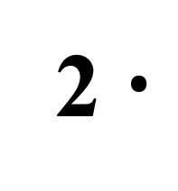
2 $∙$ 9 $∙$ 5 = ___
2 $∙$
9 $∙$ = ___
5
9 $∙$ 10 = ____

Slide 5
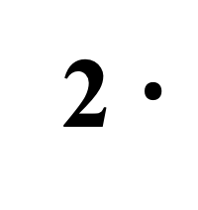
44 $∙$ 5 = ___
22 $∙$ = ___
2 $∙$
5
22 $∙$ 10 = ____

Slide 6
Another Pair!!
4 x 25
=100

Slide 7
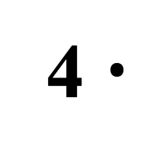
4 $∙$ 9 $∙$ 25 = ___
9 $∙$ = ___
4 $∙$
25
9 $∙$ 100 = ____

Slide 8
80 $∙$ 25 = ___
20 $∙$ = ___
4 $∙$
25
20 $∙$ 100 = ____

Slide 9
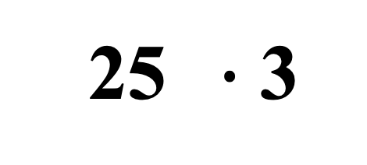
12 $∙$ 75 = ___
4 $∙$
3 $∙$ = ___
25 $∙$ 3
3 $∙$100 $∙$3 = ____

